Slide 1


Presenters: Trang Nguyen
Qi Wang

Slide 2

Executive Summary
Market Profile
Closing Price (02-27-2024) | 160.98
52 Week Range | $144.95- $175.97
Average Volume(3 M) | 7.29 M
Shares Out. | 2.41 B
Market Cap | 386.656 B
Dividend Yield | 4.76(2.96%)
Beta | 0.54
EV/Revenue | 4.63x
EV/EBITDA | 16.90x
Institutional Holdings | 71.37%
Insider Holdings | 0.09%
One of the world's largest and most broadly based healthcare companies.
Historically excellent sales performance.
Half of sales is derived from Pharmaceutical segment.
Vast portfolio across medical, pharma, and consumer goods​.
BUY
Company Overview
Industry &
Competitive position
Financial Analysis
Valuation
Risk Analysis
Conclusion

Slide 3
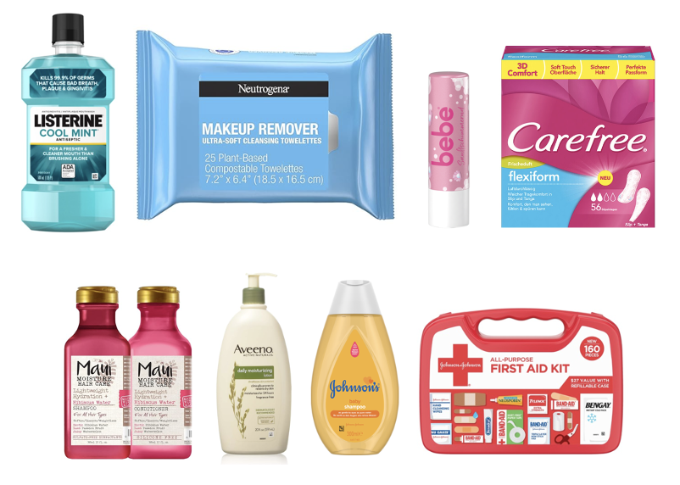
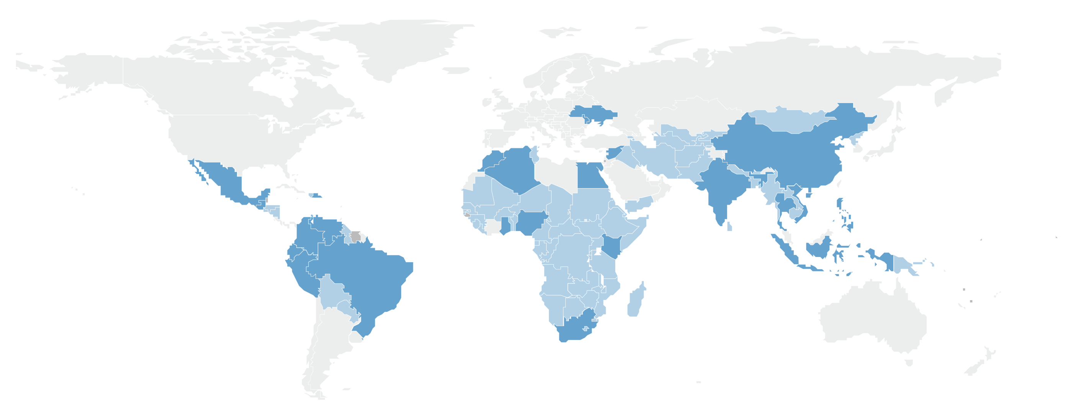
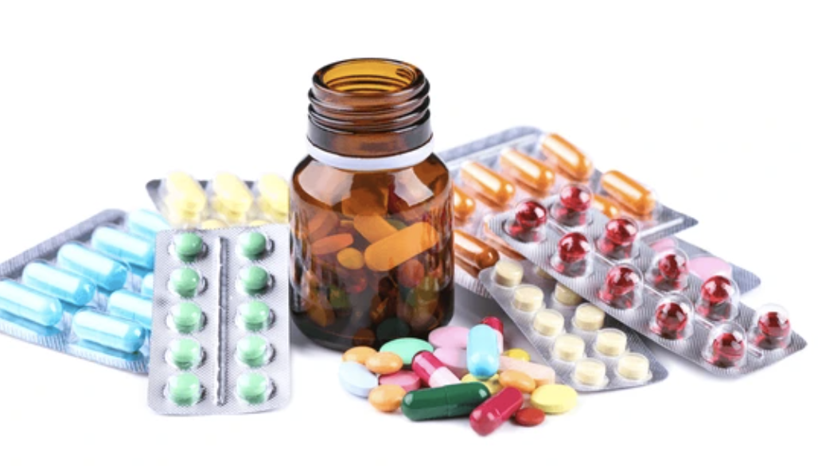

Company Overview
Consumer Health
Pharmaceuticals
MedTech
Company Overview
Industry &
Competitive position
Financial Analysis
Valuation
Risk Analysis
Conclusion

Slide 4
Competitive Advantage
Product Diversity: Johnson & Johnson's wide-ranging portfolio spans Consumer Health, Medical Devices, and Pharmaceuticals, offering a strategic blend that diversifies risk and ensures consistent revenue.
Brand Strength: Renowned for iconic brands such as Johnson’s Baby, Neutrogena, and Tylenol. Its strong brand recognition underpins its market dominance.
Worldwide Operations: With a presence in over 60 countries, Johnson & Johnson leverages its global footprint to explore growth opportunities in emerging markets.
Innovation Focus: The company's substantial investments in research and development are evidence to its commitment to innovation. This focus ensures Johnson & Johnson remains competitive by continuously introducing novel and advanced products to the healthcare market.
Company Overview
Industry &
Competitive position
Financial Analysis
Valuation
Risk Analysis
Conclusion

Slide 5
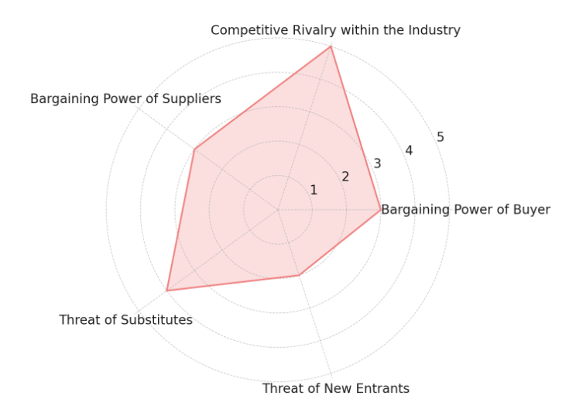
Industry Overview
Porter’s Five Forces
Bargaining Power of Customers – MODERATE
Competitive Rivalry within the Industry – HIGH
Bargaining Power of Suppliers – MODERATE
Threat of Substitutes – MODERATE TO HIGH
Threat of New Entrants – LOW
LEGEND
0 No threat to JNJ
1 Insignificant threat to JNJ 2 Low threat to JNJ 3 Moderate threat to JNJ
4 Significant threat to JNJ
5 High Threat to JNJ
Company Overview
Industry &
Competitive position
Financial Analysis
Valuation
Risk Analysis
Conclusion

Slide 6
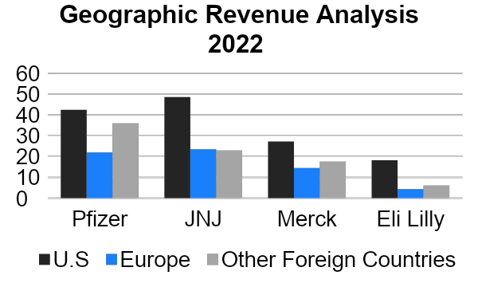


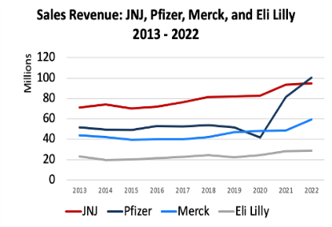

Industry Overview
Main Competitors
Company Overview
Industry &
Competitive position
Financial Analysis
Valuation
Risk Analysis
Conclusion

Slide 7
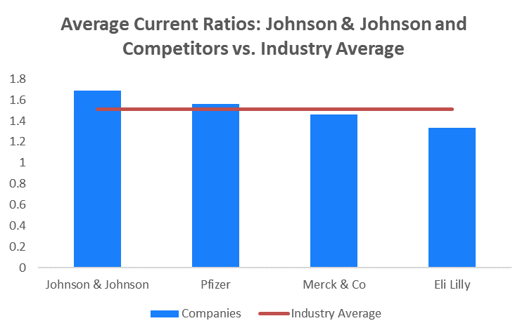
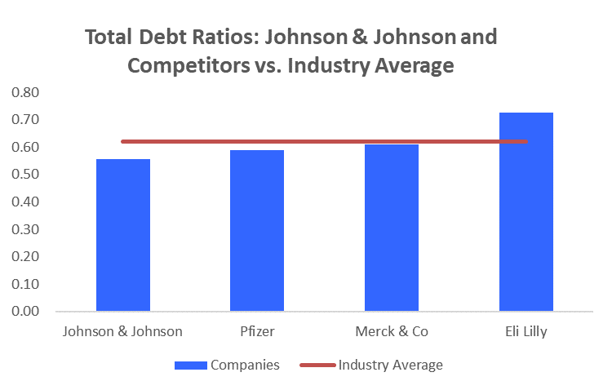
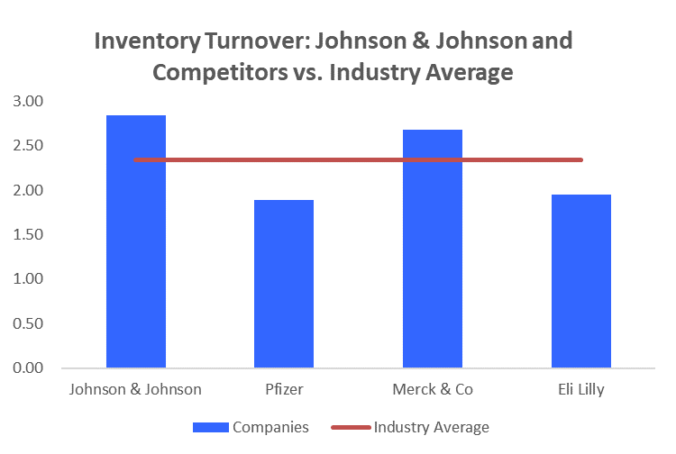
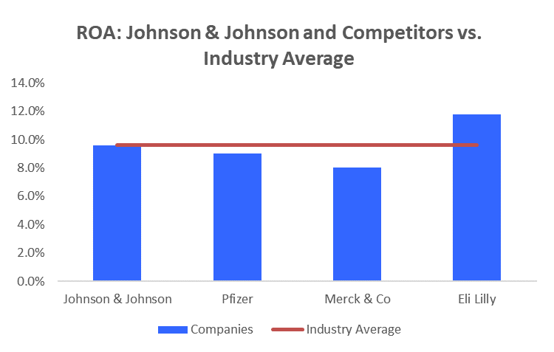
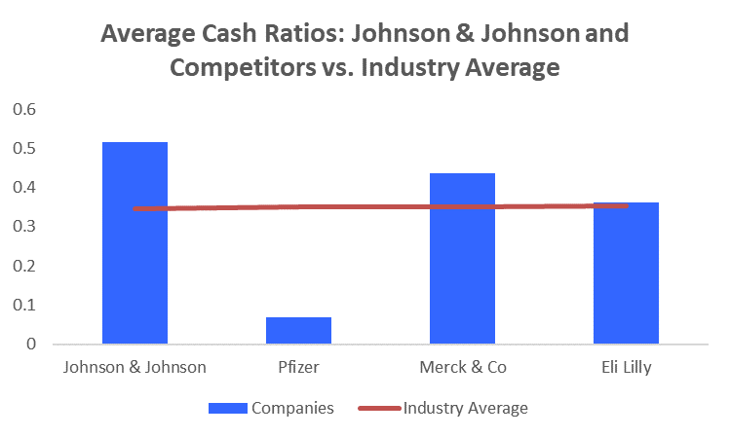
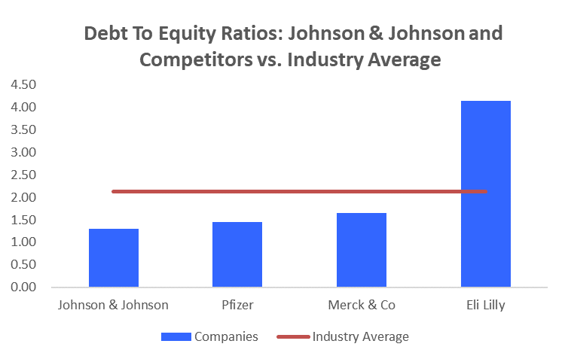
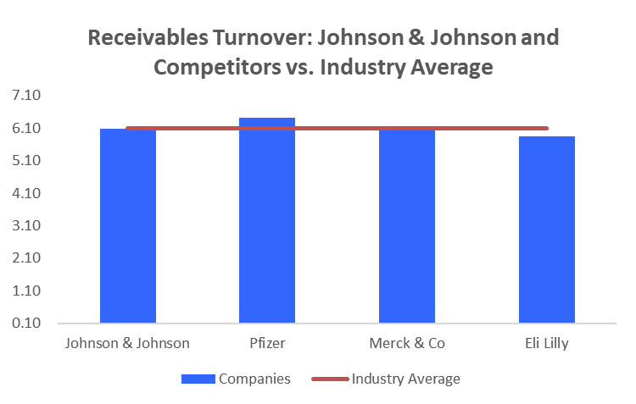
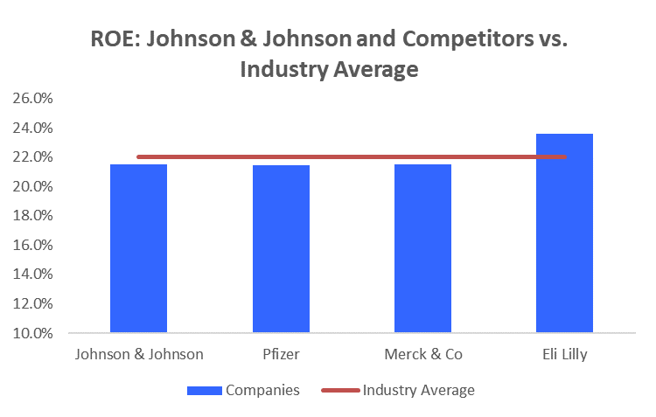
Industry Overview
Liquidity Ratios
Financial Leverage Ratios
Turnover Ratios
Profitability Ratios
Company Overview
Industry &
Competitive position
Financial Analysis
Valuation
Risk Analysis
Conclusion

Slide 8
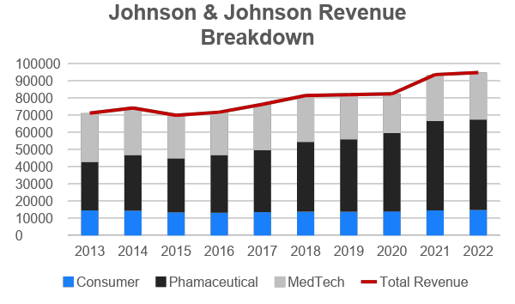
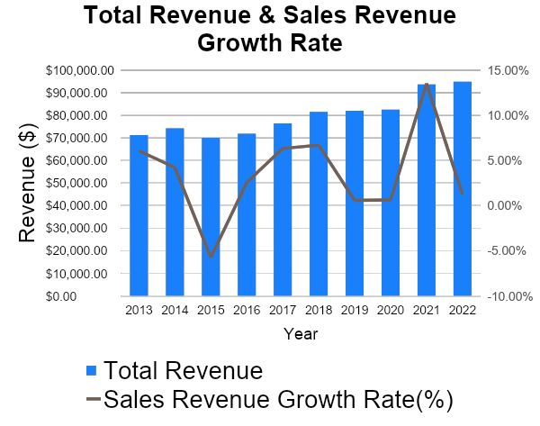
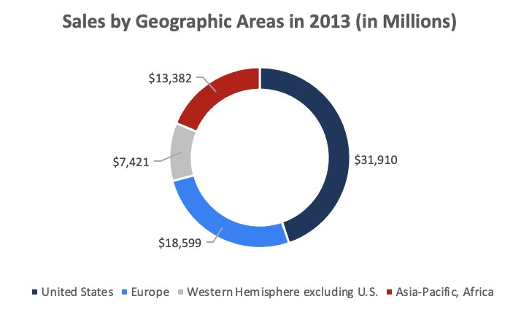
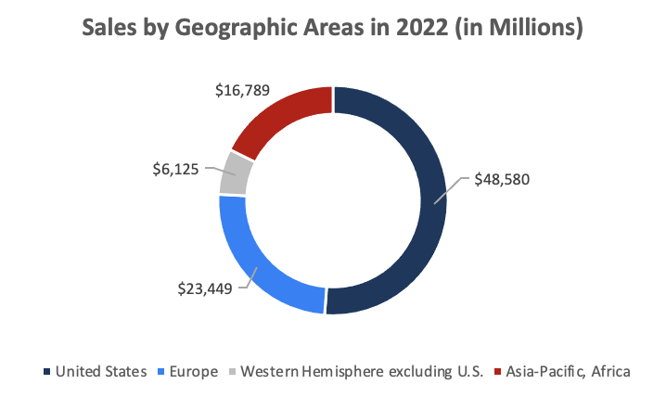
Revenue Analysis
Company Overview
Industry &
Competitive position
Financial Analysis
Valuation
Risk Analysis
Conclusion

Slide 9
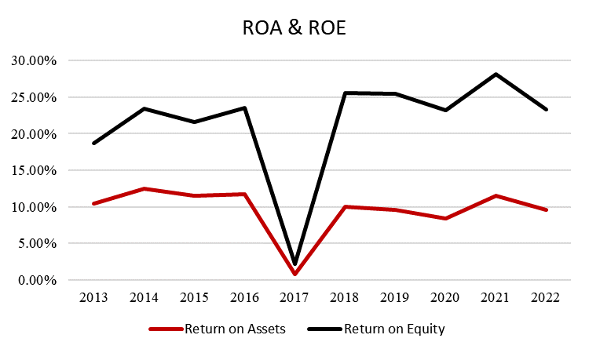
Profitability
Year | Profit Margin
2013 | 19.4%
2014 | 22.0%
2015 | 22.0%
2016 | 23.0%
2017 | 1.7%
2018 | 18.8%
2019 | 18.4%
2020 | 17.8%
2021 | 22.3%
2022 | 18.9%
Company Overview
Industry &
Competitive position
Financial Analysis
Valuation
Risk Analysis
Conclusion

Slide 10
Debt Analysis
Increased Debt Ratios: A higher proportion of assets financed through debt.
Deepened Reliance on Debt: Significant growth in the debt-to-equity ratio.
Strategic Adjustment in Long-term Debt: Long-term debt ratio rose then fell, indicating a recent reduction in dependence.
Company Overview
Industry &
Competitive position
Financial Analysis
Valuation
Risk Analysis
Conclusion

Slide 11
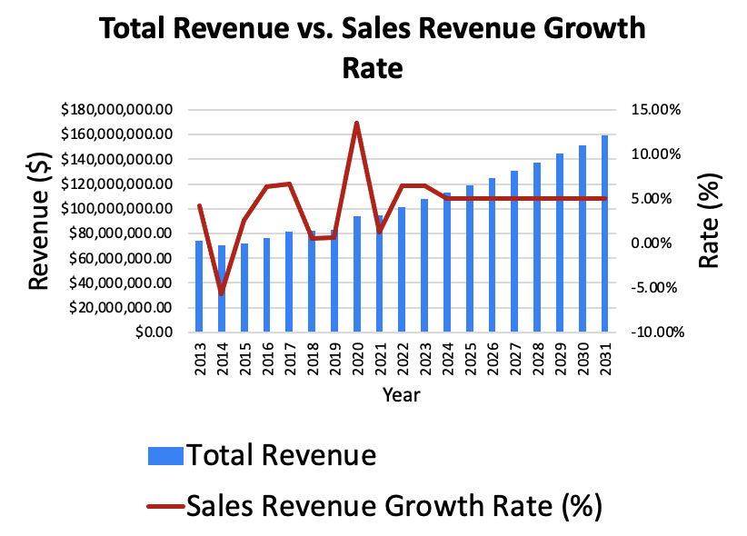
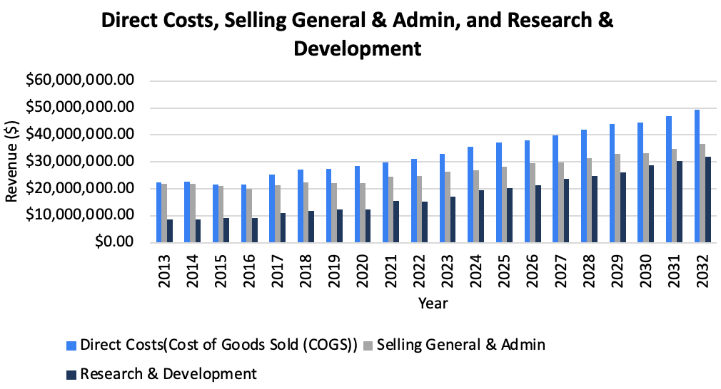
DCF Assumption - Revenue
Parameter Estimates | 2021 | 2022 | 2023 | 2024 | 2025 | 2026 | 2027 | 2028 | 2029 | 2030 | 2031 | 2032
Annual Sales Growth | 13.55% | 1.25% | 6.5% | 6.5% | 5% | 5% | 5% | 5% | 5% | 5% | 5% | 5%
COGS/Sales | 32% | 33% | 33% | 33% | 32% | 32% | 32% | 32% | 31% | 31% | 31% | 31%
RD/Sales | 17% | 16% | 17% | 18% | 18% | 18% | 19% | 19% | 19% | 20% | 20% | 20%
SGA/Sales | 26% | 26% | 26% | 25% | 25% | 25% | 24% | 24% | 24% | 23% | 23% | 23%
Depreciation/Fixed Assets | 1% | 1% | 5% | 1% | 1% | 5% | 1% | 1% | 5% | 1% | 1% | 5%
Tax rate | 8.33% | 17.42% | 13.20% | 13.20% | 13.20% | 13.20% | 13.20% | 13.20% | 13.20% | 13.20% | 13.20% | 13.20%
Cash/Sales | 15% | 15% | 17% | 19% | 20% | 20% | 20% | 20% | 20% | 20% | 20% | 20%
AR/Sales | 16% | 17% | 17% | 17% | 17% | 17% | 17% | 17% | 17% | 17% | 17% | 17%
Other Assets/Sales | 109% | 118% | 116% | 116% | 116% | 116% | 116% | 116% | 116% | 116% | 116% | 116%
Fixed Assets/Sales | 51% | 52% | 52% | 52% | 52% | 52% | 52% | 52% | 52% | 52% | 52% | 52%
AP. Acr Exp etc/Sales | 48% | 59% | 59% | 59% | 58% | 58% | 58% | 57% | 57% | 57% | 57% | 57%
Company Overview
Industry &
Competitive position
Financial Analysis
Valuation
Risk Analysis
Conclusion

Slide 12
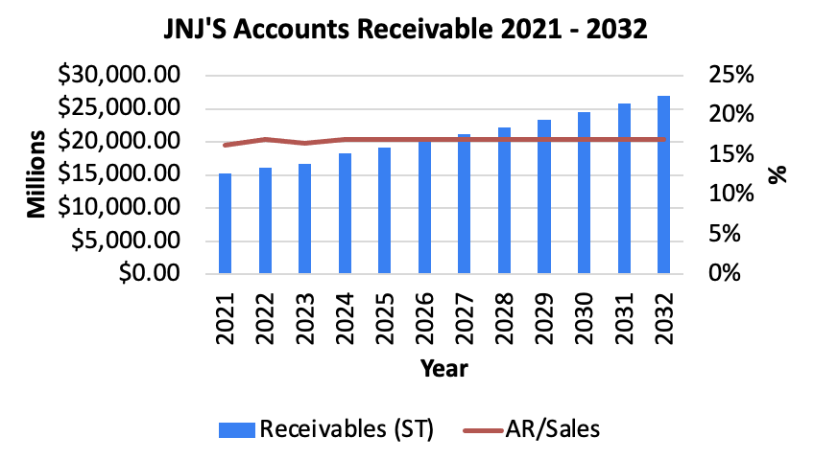
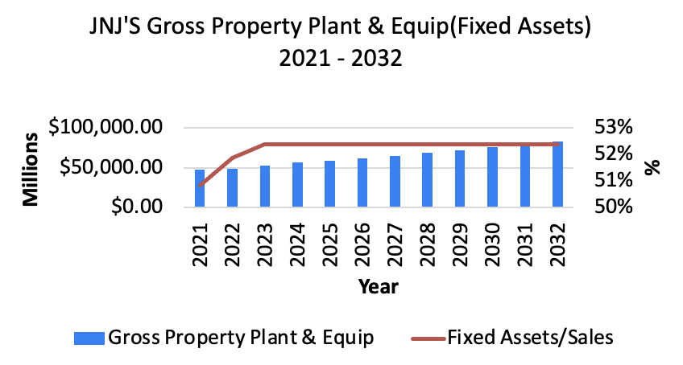
DCF Assumption - Revenue
Parameter Estimates | 2021 | 2022 | 2023 | 2024 | 2025 | 2026 | 2027 | 2028 | 2029 | 2030 | 2031 | 2032
Annual Sales Growth | 13.55% | 1.25% | 6.5% | 6.5% | 5% | 5% | 5% | 5% | 5% | 5% | 5% | 5%
COGS/Sales | 32% | 33% | 33% | 33% | 32% | 32% | 32% | 32% | 31% | 31% | 31% | 31%
RD/Sales | 17% | 16% | 17% | 18% | 18% | 18% | 19% | 19% | 19% | 20% | 20% | 20%
SGA/Sales | 26% | 26% | 26% | 25% | 25% | 25% | 24% | 24% | 24% | 23% | 23% | 23%
Depreciation/Fixed Assets | 1% | 1% | 5% | 1% | 1% | 5% | 1% | 1% | 5% | 1% | 1% | 5%
Tax rate | 8.33% | 17.42% | 13.20% | 13.20% | 13.20% | 13.20% | 13.20% | 13.20% | 13.20% | 13.20% | 13.20% | 13.20%
Cash/Sales | 15% | 15% | 17% | 19% | 20% | 20% | 20% | 20% | 20% | 20% | 20% | 20%
AR/Sales | 16% | 17% | 17% | 17% | 17% | 17% | 17% | 17% | 17% | 17% | 17% | 17%
Other Assets/Sales | 109% | 118% | 116% | 116% | 116% | 116% | 116% | 116% | 116% | 116% | 116% | 116%
Fixed Assets/Sales | 51% | 52% | 52% | 52% | 52% | 52% | 52% | 52% | 52% | 52% | 52% | 52%
AP. Acr Exp etc/Sales | 48% | 59% | 59% | 59% | 58% | 58% | 58% | 57% | 57% | 57% | 57% | 57%
Company Overview
Industry &
Competitive position
Financial Analysis
Valuation
Risk Analysis
Conclusion

Slide 13
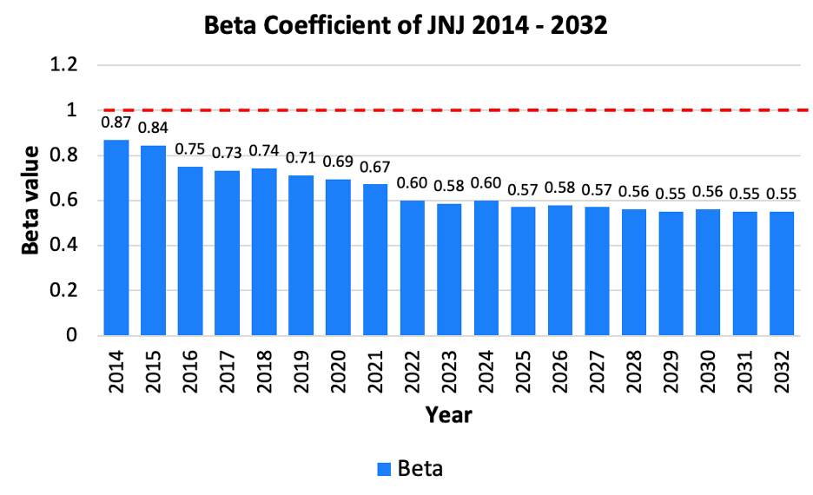
DCF Assumption - WACC
External Factors | 2023 | 2024 | 2025 | 2026 | 2027 | 2028 | 2029 | 2030 | 2031 | 2032
Risk Free Rate | 4.33% | 4.33% | 4.33% | 4.33% | 4.33% | 4.33% | 4.33% | 4.33% | 4.33% | 4.33%
Market risk premium | 5.60% | 5.60% | 5.60% | 5.60% | 5.60% | 5.60% | 5.60% | 5.60% | 5.60% | 5.60%
Interest rate on debt (cost of debt) | 4.90% | 4.90% | 4.90% | 4.90% | 4.90% | 4.90% | 4.90% | 4.90% | 4.90% | 4.90%
Annual sales growth | 4.34% | 2.86% | 2.37% | 3.41% | 5.61% | 6.89% | 2.17% | 10.11% | 14.89% | 2.34%
Cost of equity | 7.58% | 7.69% | 7.52% | 7.58% | 7.52% | 7.47% | 7.41% | 7.47% | 7.41% | 7.41%
Capital Structure (% debt) | 12.79% | 12.79% | 12.79% | 12.79% | 12.79% | 12.79% | 12.79% | 12.79% | 12.79% | 12.79%
WACC (discount rate) | 7.15% | 7.25% | 7.10% | 7.15% | 7.10% | 7.05% | 7.01% | 7.05% | 7.01% | 7.01%
Perpetual CF growth | 3.90%
Perpetual discount | 7.01%
Company Overview
Industry &
Competitive position
Financial Analysis
Valuation
Risk Analysis
Conclusion

Slide 14
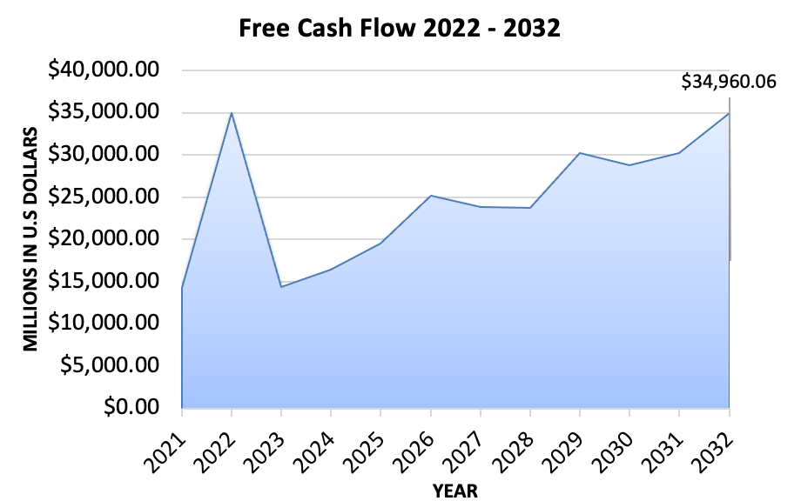
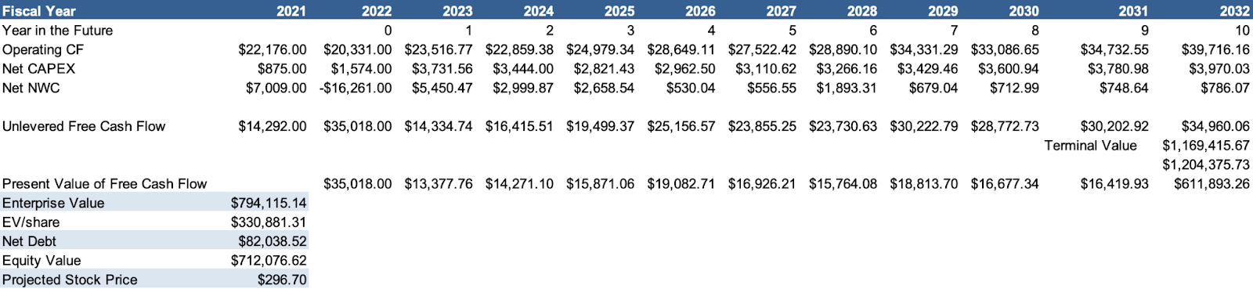
DCF Model
Company Overview
Industry &
Competitive position
Financial Analysis
Valuation
Risk Analysis
Conclusion

Slide 15
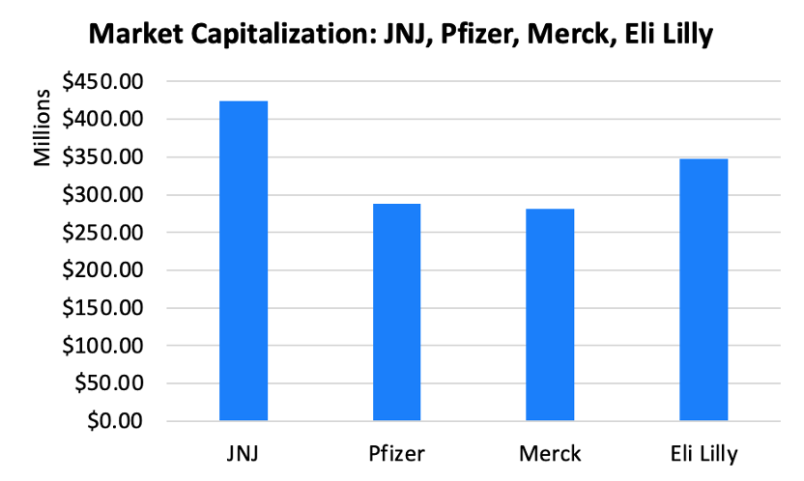
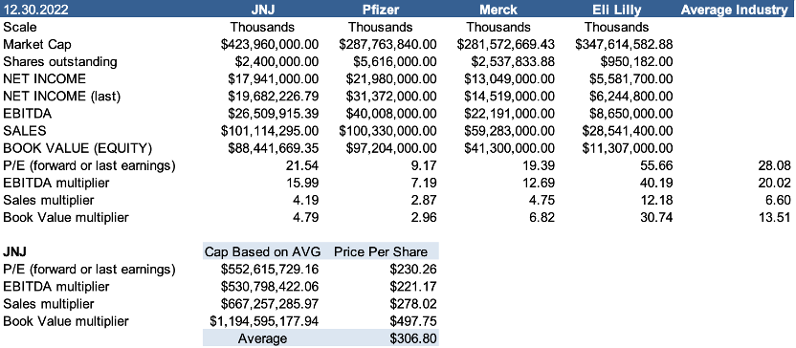
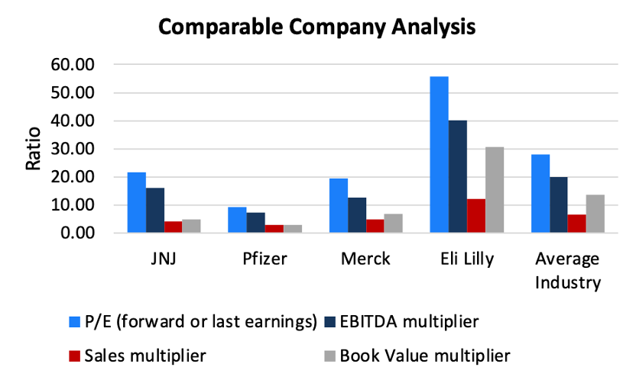
Relative Valuation
Company Overview
Industry &
Competitive position
Financial Analysis
Valuation
Risk Analysis
Conclusion

Slide 16
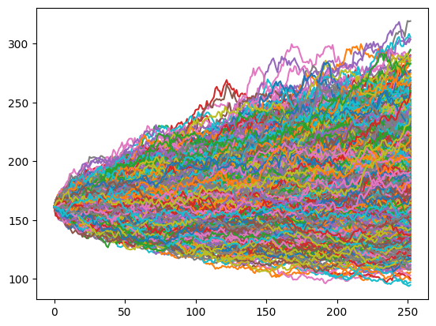
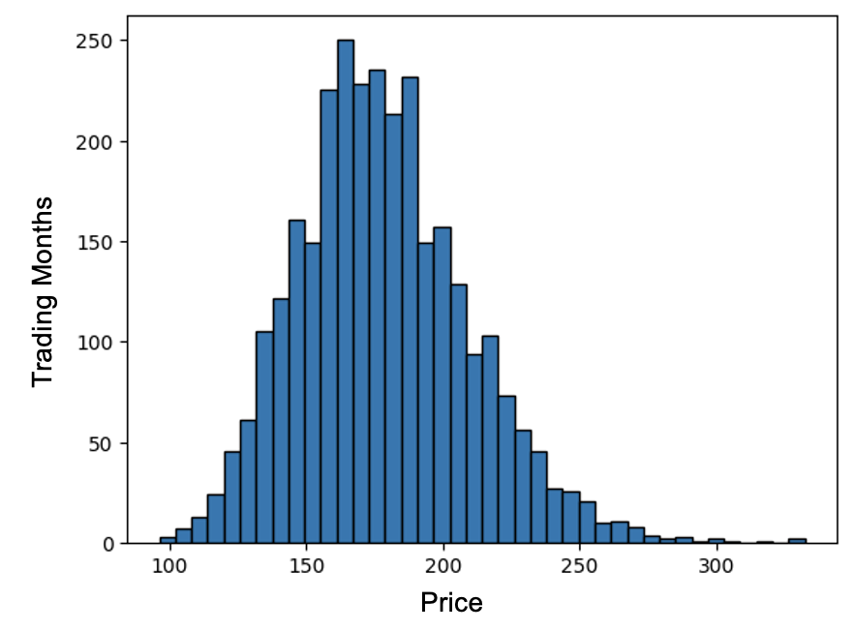
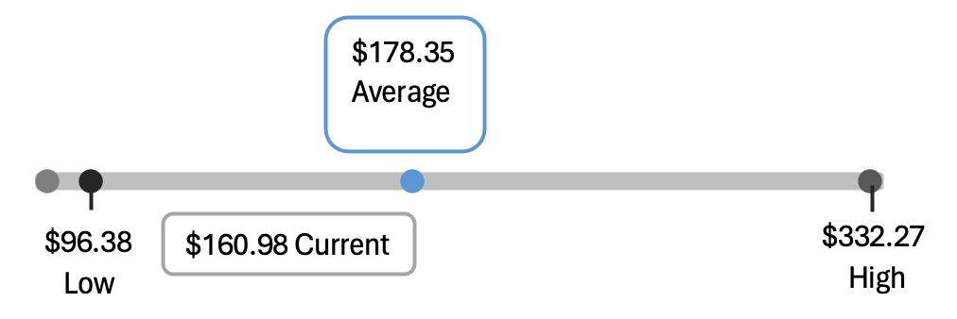
Monte Carlo Simulation
Price
162
Trading Months
Company Overview
Industry &
Competitive position
Financial Analysis
Valuation
Risk Analysis
Conclusion

Slide 17
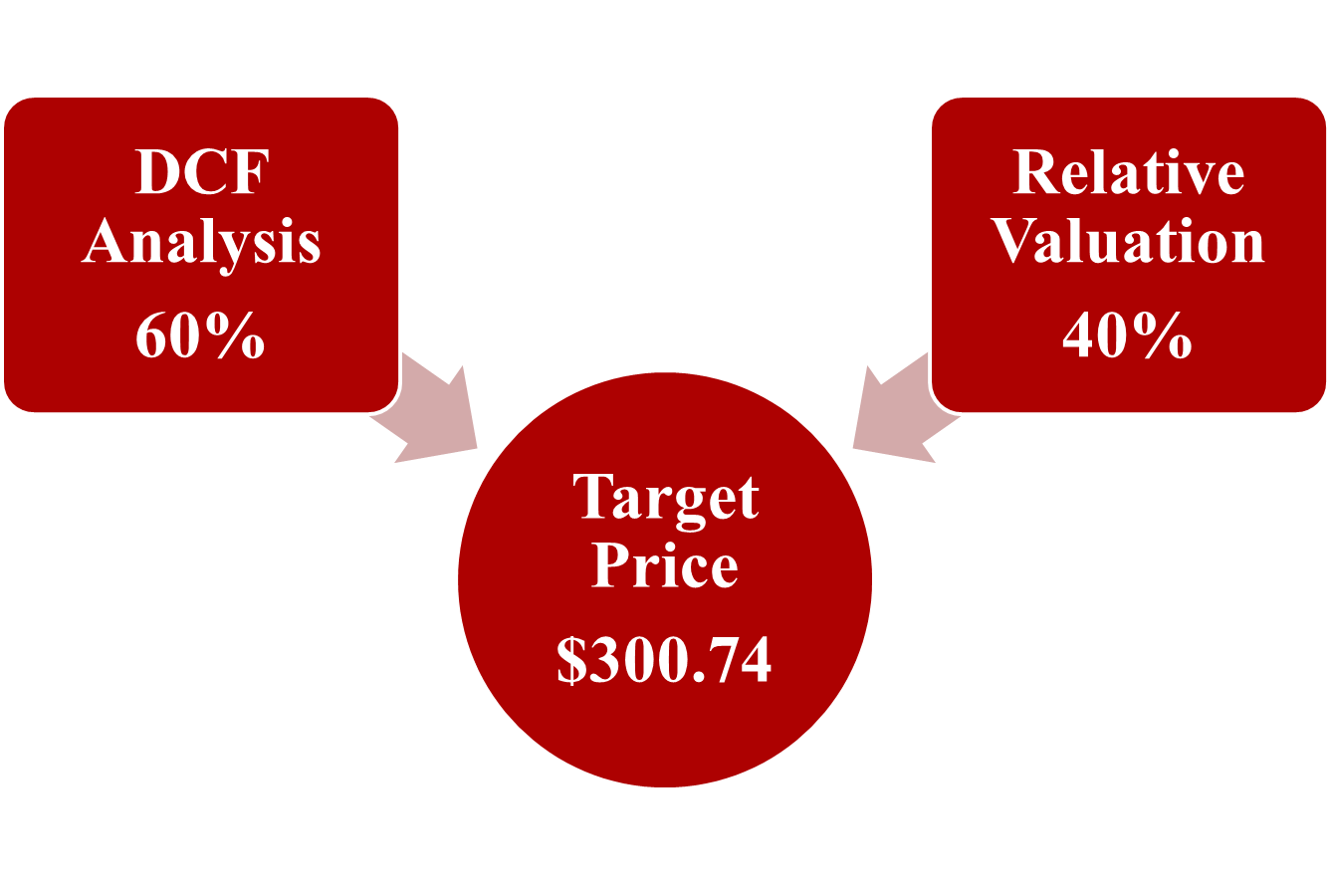
Price Target
Company Overview
Industry &
Competitive position
Financial Analysis
Valuation
Risk Analysis
Conclusion

Slide 18
Main Risks
High
OR1
RR1
RR1= Regulatory Risk ——Regulatory Challenges of Global regulatory changes and uncertainties
OR1= Operational Risk——Litigation Risks(Talcum Powder Lawsuits, Opioid Litigation, Hip Replacement Litigation)
MR1= Market Risk——Challenging competition
MR2= Market Risk——Rising Presence of Generics
MR1
MR2
Median
Low
Company Overview
Industry &
Competitive position
Financial Analysis
Valuation
Risk Analysis
Conclusion

Slide 19
Conclusion
Fundamental Analysis:
Global Leadership
Strong Financial Record
Diverse Product Range
Financial Valuation Analysis:
DCF Model
Relative Valuation
Buy
Company Overview
Industry &
Competitive position
Financial Analysis
Valuation
Risk Analysis
Conclusion

Slide 20
Thank you

